Slide 1
Spring Update 1
Dev Bhatia
Ultrafast Optics Laboratory
Boston University College of Engineering

Slide 2
Model Validation
In order to verify that the model does indeed produce an error, the paper results were sought to be reproduced
Utilized the following parameters:
t = 500 ms
ua = 0.502 cm^-1
r = 5 um
R = 43.6 um OR 33.9 um (the paper gives multiple values)

Slide 3
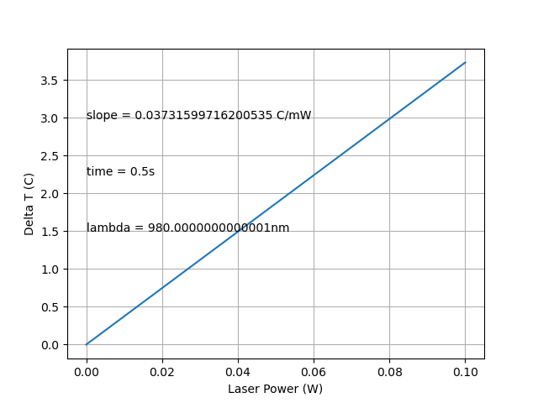
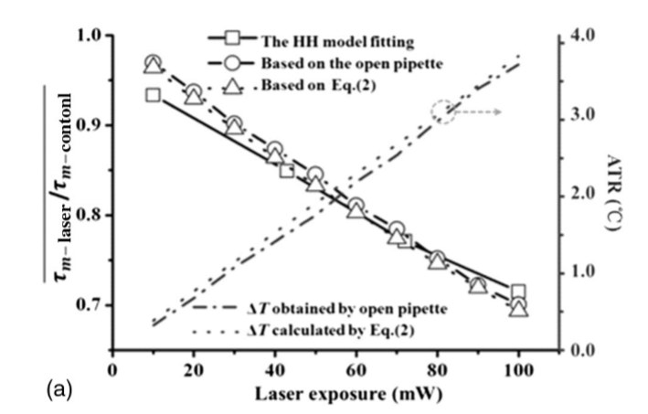
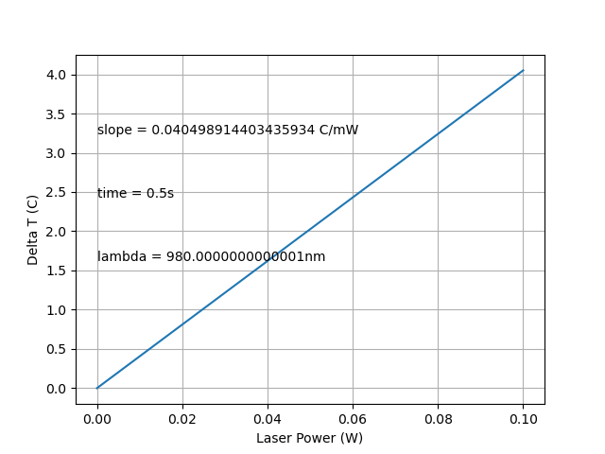
Model Validation (cont.)
Fig 1. ADTR, R = 43.6 um
Fig 2. ADTR, paper
Fig 3. ADTR, R = 33.9 um

Slide 4
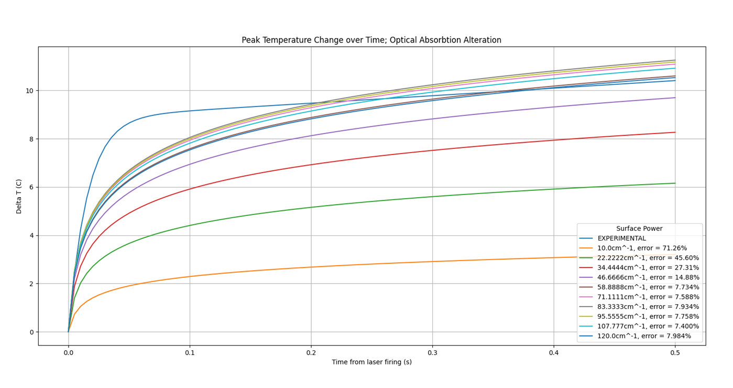
Optical Absorption Coefficient Discrepancies
Increasing the optical absorption coefficient within a reasonable range does not produce a clear trajectory
Fig 4. Erroneous Absorption Coeff

Slide 5
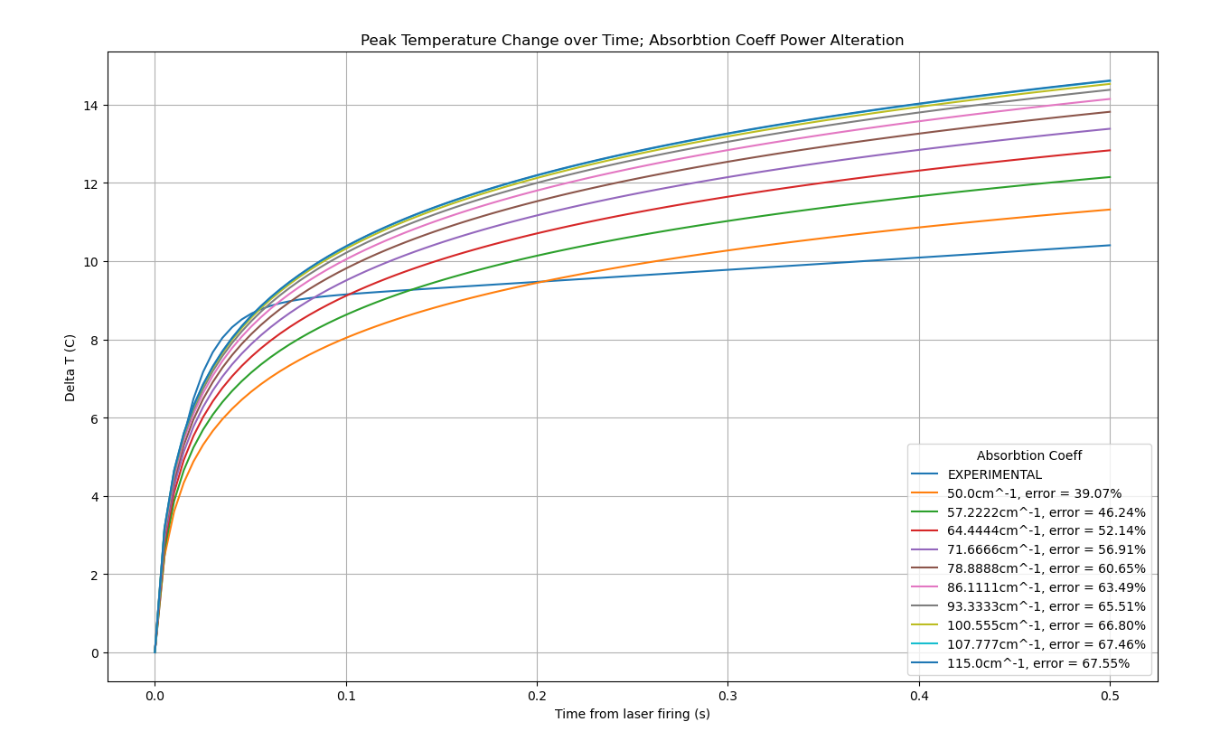
Optical Absorption Coefficient Discrepancies (cont.)
Fig 5. Adjusted OAC

Slide 6
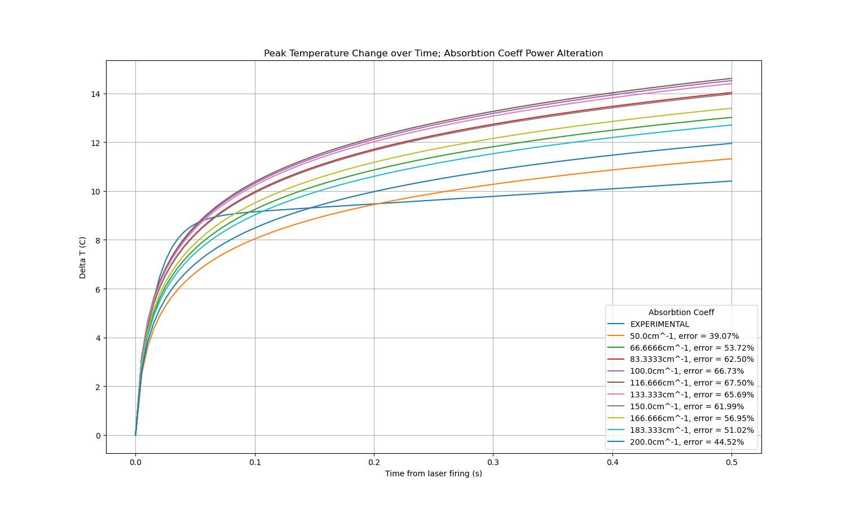
Optical Absorption Coefficient Discrepancies (cont.)
Fig 6. Pushed OAC

Slide 7
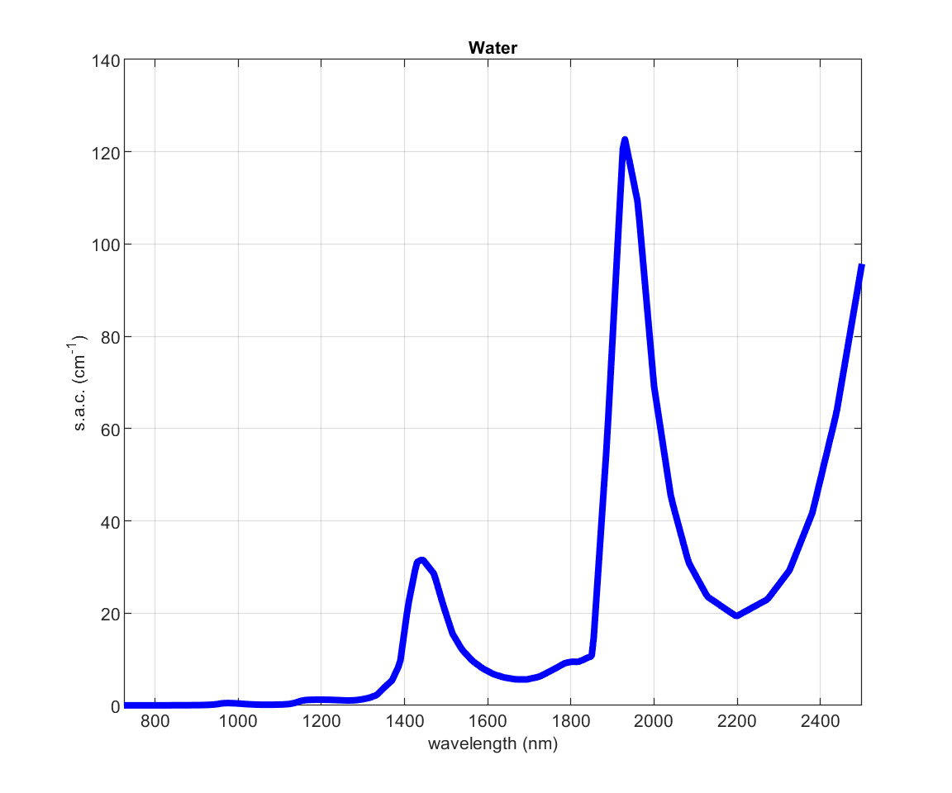
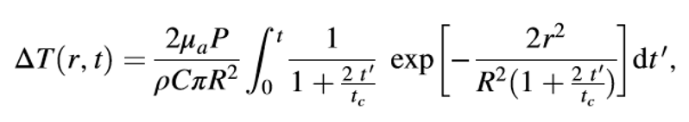

Optical Absorption Coefficient Discrepancies (cont.)
Fig 7. Target Equation
Fig 8. P dependency
Figure 9 –
Specific absorption coefficient of water (725-2500nm) linearly interpolated from original data with a resolution of 5nm

Slide 8
Next Steps
Fit first 20 ms of experimental data in Matlab, reoptimize
Calculate radius considering reflective index
Start sourcing alternative models

